Slide 1
Exploratory

Slide 2

https://exploratory.io/

Slide 3
Skills development
Data wrangling
Descriptive analytics
Explanatory analytics
Predictive analytics
Prescriptive analytics

Slide 4
Data wrangling
Data wrangling is the set of activities required to clean data prior to analytics
Includes
Reading a file
Normalizing or converting from broad to narrow format
Extracting rows or columns
Creating new columns
Transforming columns

Slide 5
Normalization
Each row is
uniquely identified
contains one observation

Slide 6
Normalizing a spreadsheet

Slide 7
dplyr - A grammar of data manipulation
Function | Purpose
filter() | Select rows
select() | Select columns
arrange() | Sort rows
summarize() | Compute a single summary statistic
group_by() | Pair with summarize() to analyze groups within a dataset
inner_join() | Join two tables
mutate() | Create a new column
case_when() | Recode a column
distinct() | Select distinct rows
sample_n() & sample_frac | Select a random sample by number or fraction

Slide 8
Input files
Text
Spreadsheet
Database

Slide 9
Descriptive analytics
Tables
Graphs
Maps

Slide 10
EX1: Class walk through
Read shipping data
shipping.csv (millions of tons per year by registered country) (file link in module contents)
Rename ‘country’ to ‘Country’
Use gather to normalize
Identifier is country + year
Extract data for Denmark, Norway, and Sweden
Filter
Prepare a graphic showing tonnage for the three countries for each year
Viz with Line
Year(x), Tons (y), Country(color)

Slide 11
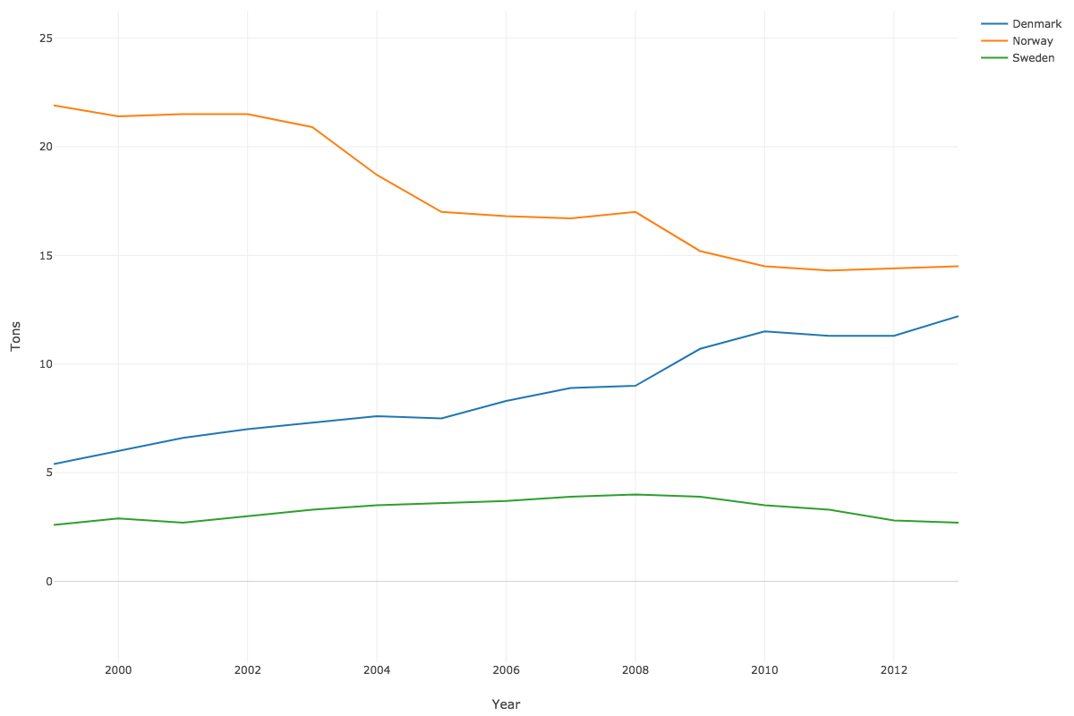

Slide 12
EX1: Class walk through (cont.)
Prepare a table of mean tonnage for the three countries with the mean rounded to two decimal places
Mutate with round
Viz with Table
Prepare a bar chart of mean tonnage for the three countries
Viz with Bar

Slide 13
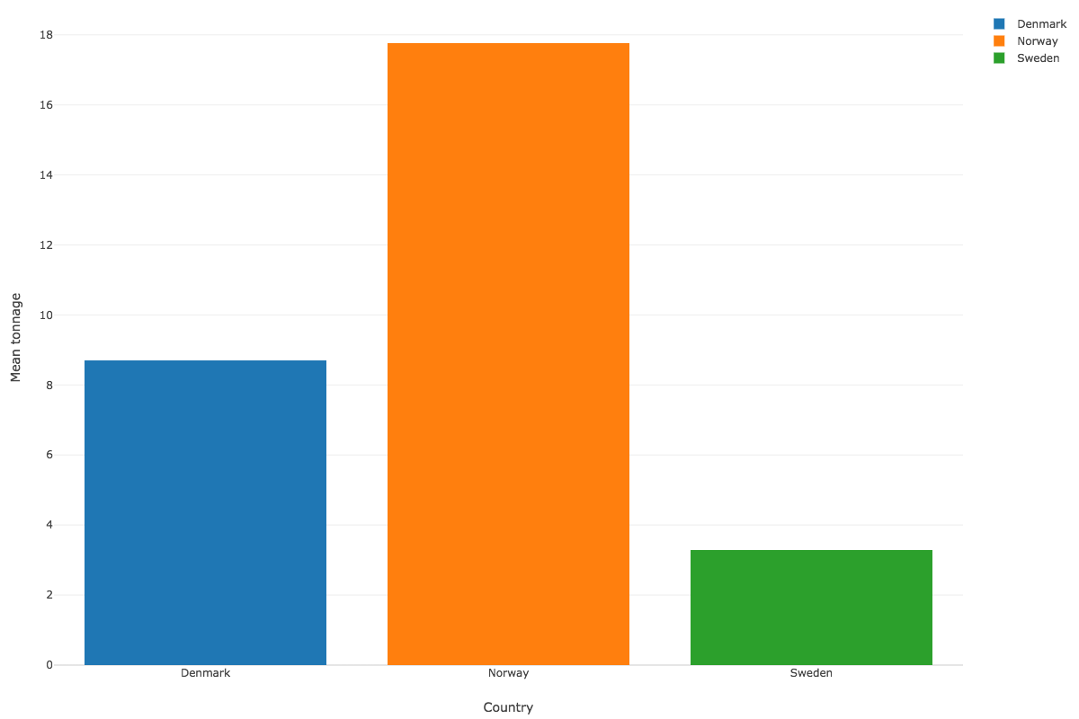

Slide 14
EX1: Class walk through (cont.)
Create a column with the ISO A2 code for the three countries (DK, NO, SE)
Mutate with case_when
case_when(
Country == 'Denmark' ~ 'DK',
Country == 'Norway' ~ 'NO',
Country == 'Sweden' ~ 'SE')
* Copy and paste of the above code sometimes does not work. Type instead.
Create a map showing the mean tonnage for each country
Viz – Map-GeoJSON

Slide 15
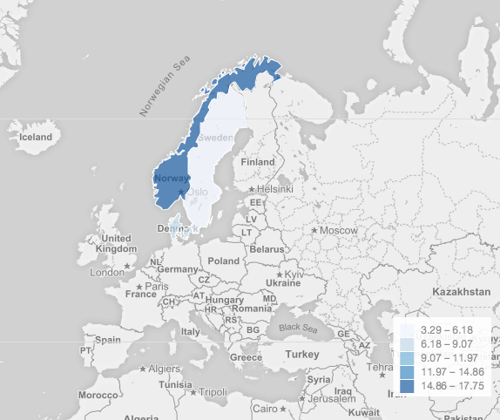

Slide 16
Class assignment #1

Slide 17
World energy production
Based on data from http://3.132.224.162/data/EnergyStats.xlsx
Plot the energy use of the current five largest economies for 1990 – 2016
USA, China, Japan, Germany, France
Prepare a map for the current five largest economies showing energy consumption in 2016
Submission – Publish your charts on Exploratory. Screenshot the images and upload 1 Word file with plot and map and the names of the 2 people who worked on it.

Slide 18
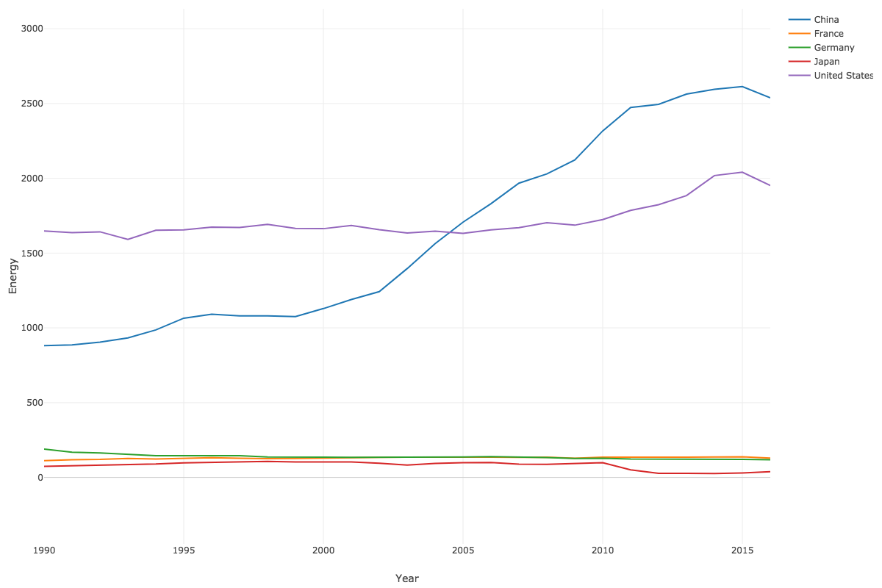

Slide 19
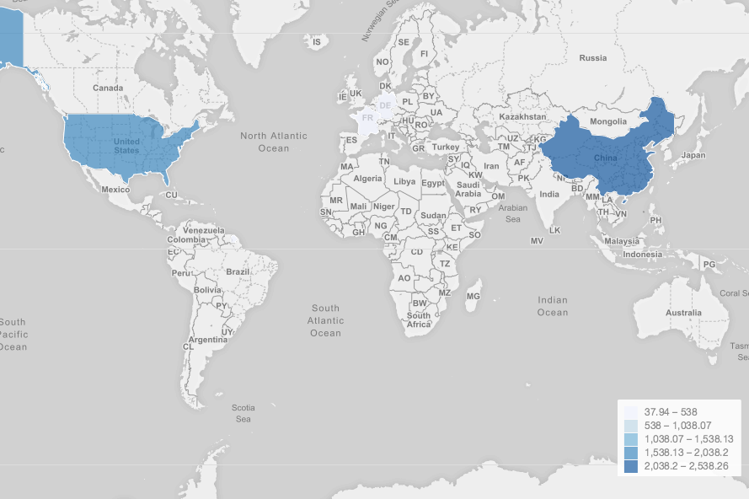

Slide 20
Explanatory analytics
Data wrangling for multiple regression
Specifying a model
Visualizing the explanation
Checking the model

Slide 21
Ex2: Class walk through (cont)
Based on the Manheim case
http://aisel.aisnet.org/cais/vol1/iss1/20/
Use Manheim car sales data
manheim.csv
Visualize price, miles, and model
Viz - scatter

Slide 22
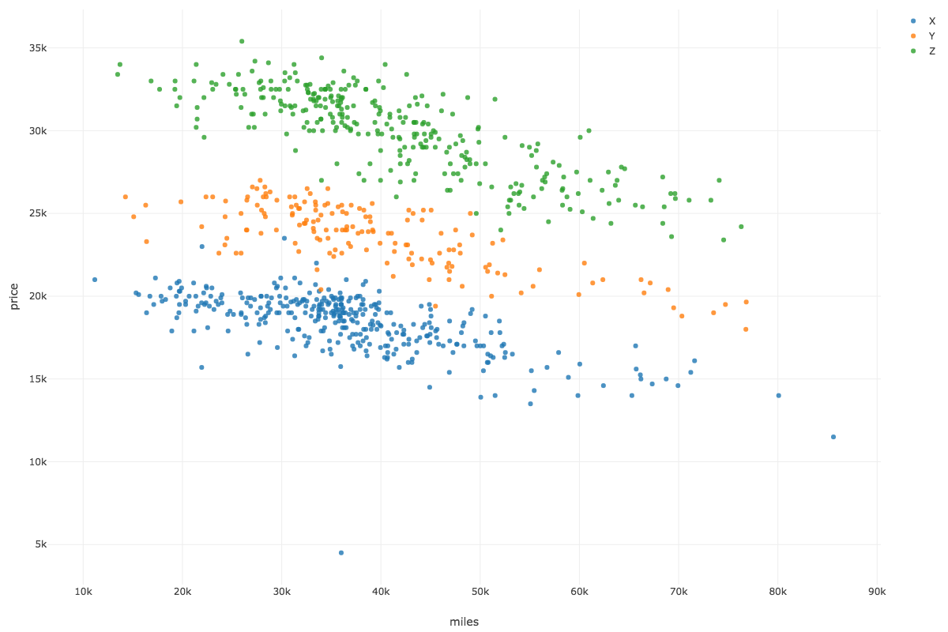

Slide 23
Ex2: Class walk through
Visualize price, miles, and sale
Viz - scatter

Slide 24
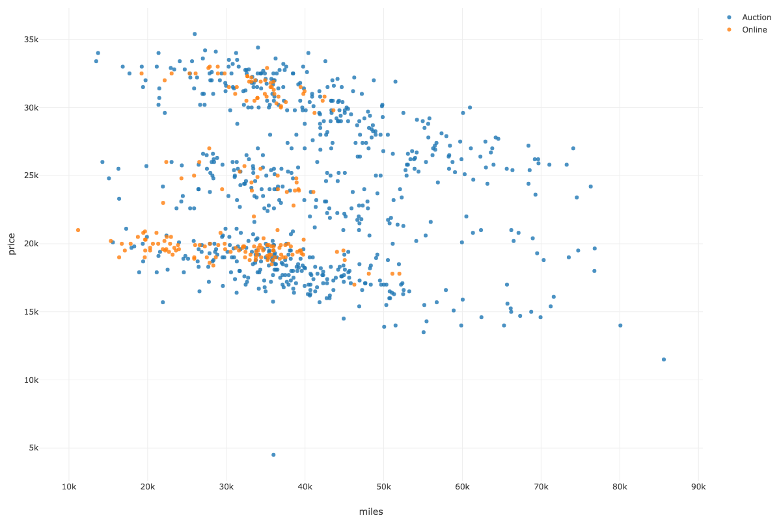

Slide 25
Ex2: Class walk through
Create a model of the form
price = f(miles, model, sale)
Build model – Build GLM
Explain the difference in the prices of cars
Term | Estimate | P-value
(Intercept) | 22887.74 | 0.00
miles | -0.13 | 0.00
modelZ | 12240.00 | 0.00
modelY | 5616.91 | 0.00
saleOnline | 591.75 | 0.00

Slide 26
Ex2: Class walk through
Create a model of the form
price = f(miles, model, sale)
Build model – Build GLM
Explain the difference in the prices of cars
Graph residuals
price vs residuals
Viz – Scatter
Are there any problems?

Slide 27
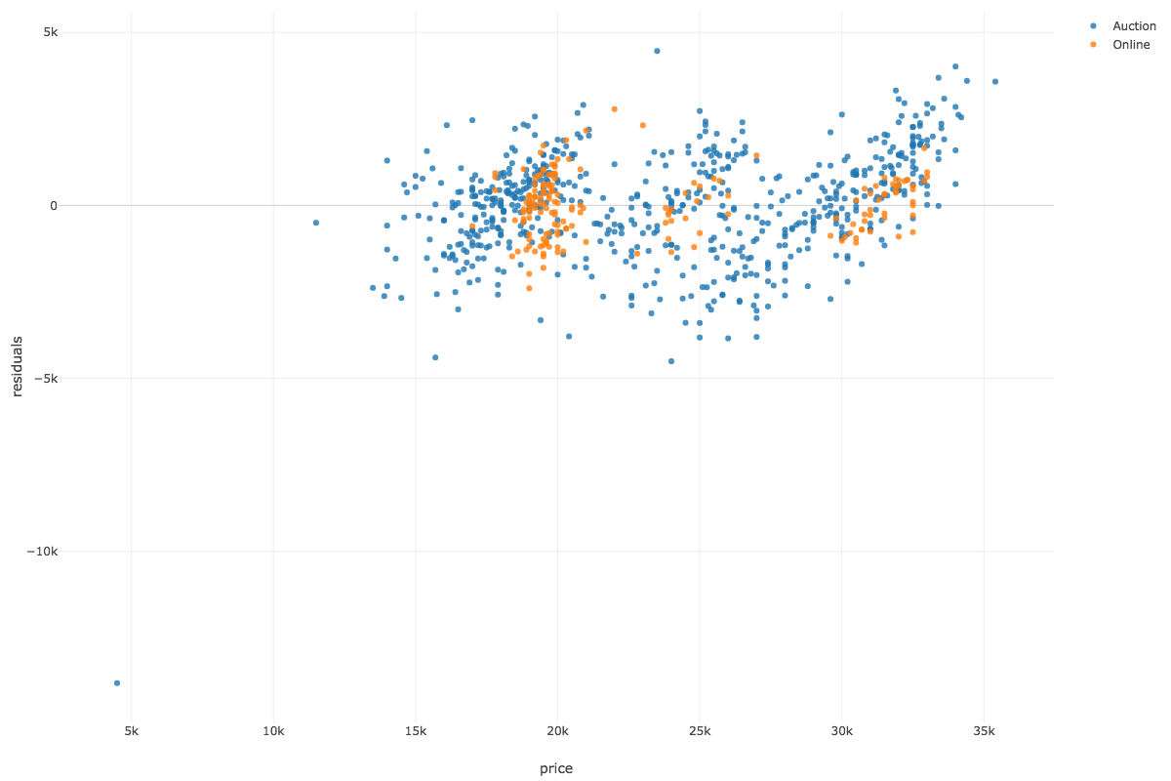

Slide 28
Predicting or setting price
Price = 22888 + -.13*miles + modelType + saleType

Slide 29
Class assignment #2

Slide 30
New York City bike counts
New York City Department of Transportation (DOT) conducts regular bike counts on the East River bridges. DOT installed automated counters, which provide continuous 24 hour data every day of the year. The dataset also contains temperature and precipitation data.
NYCBiking.xlsx

Slide 31
New York City bike counts
Prepare the file for analysis
Report trips into and out of Manhattan by bridge and day of the week? (Pivot table)
Develop a linear regression model to predict trips each day of the week for each bridge. Variable determination should result depicted in residual plot in the following slides.
Do you have any concerns with the model?

Slide 32
Submission – Publish your tables and charts on Exploratory. Screenshot the images and upload 1 Word file with the names of the 2 people who worked on it. Turn in the following
Trips Analysis - Bridge by Day of Week
Linear Regression analysis and interpretation (sig + estimate)
Residuals Analysis (graph)

Slide 33
Trips analysis
Bridge | 1 | 2 | 3 | 4 | 5 | 6 | 7
Brooklyn | 74,976 | 98,293 | 96,882 | 105,796 | 99,524 | 90,949 | 82,150
Manhattan | 119,802 | 167,072 | 172,546 | 182,564 | 167,546 | 148,612 | 123,036
Queensboro | 95,959 | 137,135 | 142,701 | 156,830 | 146,057 | 131,761 | 109,912
Williamsburg | 134,471 | 198,705 | 211,339 | 227,478 | 210,312 | 186,200 | 149,922

Slide 34
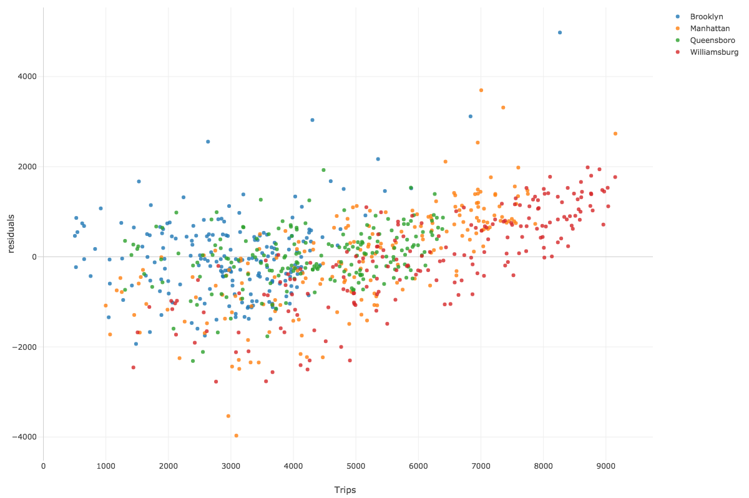
Residuals analysis

Slide 35
Predictive analytics
Data wrangling to create a time series
Time series analysis
Time series visualization
Time series prediction

Slide 36
Ex 3: Class walk through
Read carbon emissions
carbon-1651-present.csv
Discard before 1958
Create a new column, timestamp, of the form
year-7-1 00:00:00
Mutate (Create Calculation) > paste(year,’-7-1 00:00:00’)
Convert character string to timestamp
Change Data Type to year, month, day, hour, minute, second

Slide 37
Ex 3: Class walk through (cont)
Create forecast
Run Analytics > Run Time Series Forecast
Aggregate to year
Forecast CO₂
Plot year by forecast and actual
What do you conclude about the accuracy of the forecast and its meaning?

Slide 38
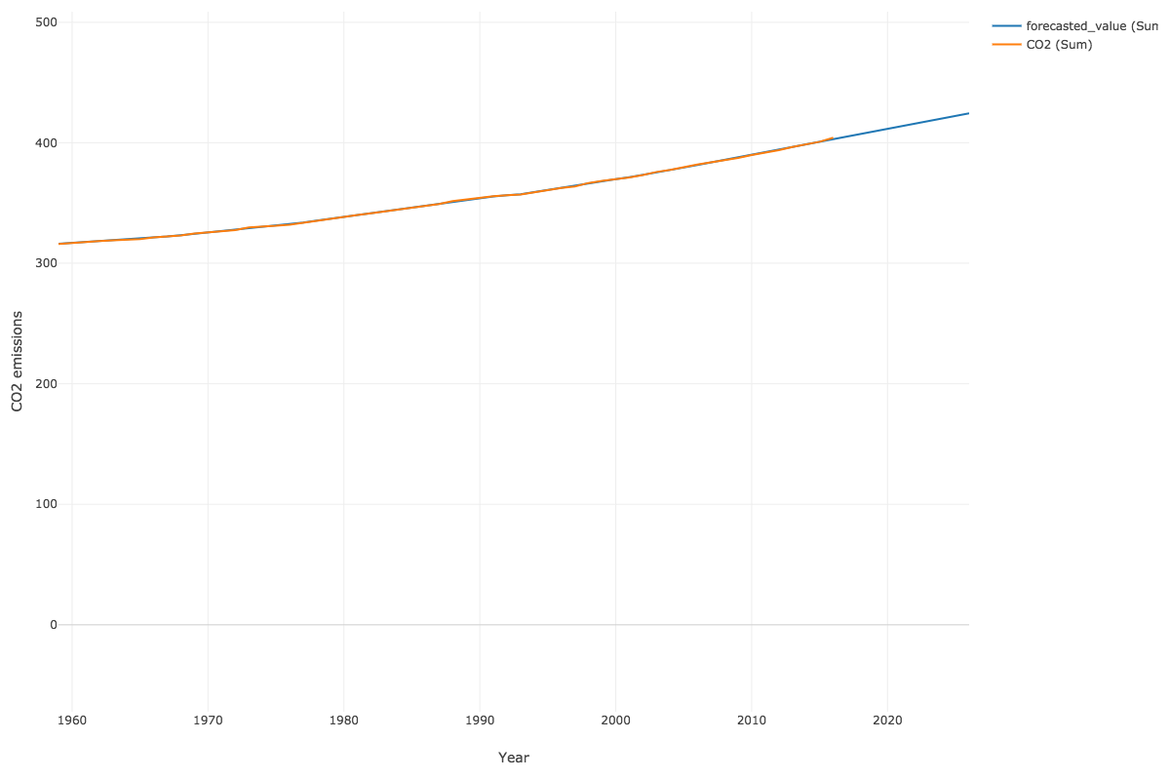

Slide 39
Class assignment #3

Slide 40
Load a bit over a year’s worth of retail data for a EU online store
OnlineRetail.csv
Compute the revenue of each sale
Forecast total weekly revenue for the next 10 weeks
Should you consider seasonality?
Create a visualization showing actual and trend

Slide 41
Submission – Publish your tables and charts on Exploratory. Screenshot the images and upload 1 Word file with the names of the 2 people who worked on it. Turn in the following
Forecast for the next 10 weeks
Visualization showing actual and trend

Slide 42
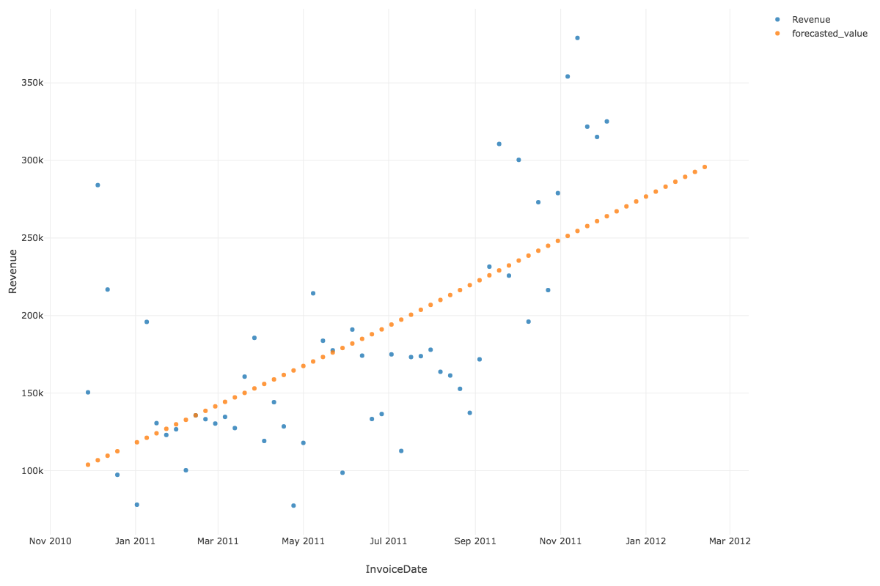
Weekly sales forecast

Slide 43
Prescriptive analytics
Read from a database
Data wrangling for basket of good analysis
Basket of goods analysis using association
Prescribe rules

Slide 44
Class walk through
Basket of goods analysis on ClassicModels
Extract order Id and product name
library(DBI)
library(RMySQL)
conn <- dbConnect(RMySQL::MySQL(), "richardtwatson.com", dbname="ClassicModels", user=”student", password="student")
t <- dbGetQuery(conn, 'SELECT productName, orderNumber FROM Products JOIN OrderDetails ON Products.productCode = OrderDetails.productCode;’)
OR
http://3.132.224.162/data/ClassicModels_source.csv

Slide 45
Association rule mining: basket of goods analysis
Support
The proportion of the times an itemset occurs in the dataset
Vary until you get a response in a reasonable time
Confidence
Probability that a rule is correct
Lift
The ratio by which the confidence of a rule exceeds the expected confidence
1 indicates items are independent and there is no relationship
Look for lift > 1

Slide 46
Class walk through (cont)
Run analytics > Run Association Rules
Adjust min_support until you get rid of the error.
Show support with 4 decimals
Show confidence and lift with 2 decimals
Compute the number of transactions for each pair
Hint there are 326 orders in ClassicModels
Notes:
.005

Slide 47
Class work through (cont)
There are too many rules
Filter to all those above 25 transactions
What would you prescribe?

Slide 48
Class assignment #4

Slide 49
Load a bit over a year’s worth of retail data for an EU online store
http://3.132.224.162/data/OnlineRetail.csv
Do an association analysis
What variables should you use?
Should you filter the data?
What do the results reveal?
Interpret the measures of support, confidence and lift for 3 rules (hint – caculate NosOfSupportingTransactions)

Slide 50
Submission – Publish your rule table on Exploratory. Screenshot the images and upload 1 Word file with the names of the 2 people who worked on it. Turn in the following
Rule table
Interpretation of 3 rules

